Slide 1

UNIT II JavaScript
Dr. Roshan d Suvaris
Nmamit nitte

Slide 2
Origins
JavaScript, which was originally developed at Netscape by Brendan Eich, was initially named Mocha but soon after was renamed LiveScript.
In late 1995 LiveScript became a joint venture of Netscape and Sun Microsystems, and its name again was changed, this time to JavaScript.
A language standard for JavaScript was developed in the late 1990s by the European Computer Manufacturers Association (ECMA) as ECMA-262.
The official name of the standard language is ECMAScript.

Slide 3
Continued…
JavaScript can be divided into three parts: the core, client side, and server side.
The core is the heart of the language, including its operators, expressions, statements, and subprograms.
Client-side JavaScript is a collection of objects that support the control of a browser and interactions with users.
Server-side JavaScript is a collection of objects that make the language useful on a Web server—for example, to support communication with a database management system.

Slide 4
JavaScript and Java
One important difference is support for object-oriented programming. Although JavaScript is sometimes said to be an object-oriented language, its object model is quite different from that of Java and C++
Java is a strongly typed language.
Variables in JavaScript need not be declared and are dynamically typed
Another important difference between Java and JavaScript is that objects in Java are static and objects in JavaScript is dynamic
The main similarity between Java and JavaScript is the syntax of their expressions, assignment statements, and control statements.

Slide 5
Uses of JavaScript
The original goal of JavaScript was to provide programming capability at both the server and the client ends of a Web connection.
Client-side JavaScript can serve as an alternative for some of what is done with server-side programming, in which computational capability resides on the server and is requested by the client.- Load Transfer
Interactions with users through form elements, such as buttons and menus, can be conveniently described in JavaScript.
Another interesting capability of JavaScript was made possible by the development of the Document Object Model (DOM), which allows JavaScript scripts to access and modify the style properties and content of the elements of a displayed HTML document, making formally static documents highly dynamic.

Slide 6
Browsers and HTML-JavaScript Documents
If an HTML document does not include embedded scripts, the browser reads the lines of the document and renders its window according to the tags, attributes, and content it finds.
When a JavaScript script is encountered in the document, the browser uses its JavaScript interpreter to “execute” the script.
Output from the script becomes the next markup to be rendered. When the end of the script is reached, the browser goes back to reading the HTML document and displaying its content.
There are two different ways to embed JavaScript in an HTML document:
explicit embedding – JavaScript code physically resides in the HTML document – head/body
implicit embedding – JavaScript can be placed in its own file

Slide 7
2 Object Orientation and JavaScript
As stated previously, JavaScript is not an object-oriented programming language. Rather, it is an object-based language.
JavaScript does not have classes.
Despite the fact that JavaScript is not an object-oriented language, much of its design is rooted in the concepts and approaches used in object-oriented programming.
const person = { firstName: "Jane", lastName: "Doe", age: 30, isStudent: false, hobbies: ["reading", "hiking", "cooking"], address: { street: "123 Main St", city: "Anytown", zipCode: "12345" }, greet: function() { console.log(`Hello, my name is
${this.firstName} ${this.lastName}.`); } };
// Accessing properties using dot notation console.log(person.firstName); // Output: Jane console.log(person.address.city); // Output: Anytown // Accessing properties using bracket notation (useful for dynamic keys) console.log(person["lastName"]); // Output: Doe // Calling a method person.greet(); // Output: Hello, my name is Jane Doe.

Slide 8
2.1 JavaScript Objects
In JavaScript, objects are collections of properties
Each property is either a data property or a function or method property.
Data properties appear in two categories: primitive values and references to other objects.
All primitive values in JavaScript are accessed directly—these are like the scalar types in Java and C++.
The properties of an object are referenced by attaching the name of the property to the variable that references the object. - myCar.engine. (myCar is object and engine is a property)
A JavaScript object appears, both internally and externally, as a list of property–value pairs.
The properties are names; the values are data values or functions.
All functions are objects and are referenced through variables.
The collection of properties of a JavaScript object is dynamic: Properties can be added or deleted at any time during execution.

Slide 9
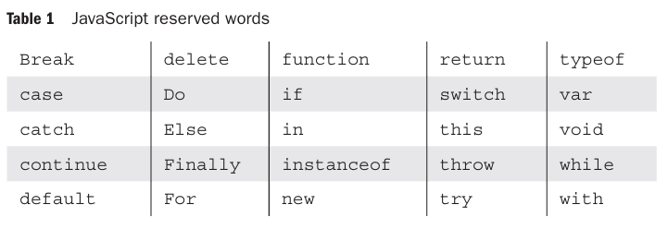
3 General Syntactic Characteristics
Scripts can appear directly as the content of a <script> tag. The type attribute of <script> must be set to "text/javascript".
The JavaScript script can be indirectly embedded in an HTML document with the src attribute of a <script> tag
<script type = "text/javascript" src = "tst_number.js" >
</script>
In JavaScript, identifiers, or names, are similar to those of other common programming languages.
They must begin with a letter, an underscore (_), or a dollar sign ($). Subsequent characters may be letters, underscores, dollar signs, or digits.
Identifiers are case sensitive.

Slide 10
Continued…
JavaScript has two forms of comments, both of which are used in other languages.
First, whenever two adjacent slashes (//) appear on a line, the rest of the line is considered a comment.
Second, /* may be used to introduce a comment, and */ to terminate it, in both single- and multiple-line comments.
Two issues arise regarding embedding JavaScript in HTML documents:
First, some browsers that are still in use recognize the <script> tag but do not have JavaScript interpreters. – Ignore the tags.
Second, a few browsers that are still in use are so old that they do not recognize the <script> tag. - Such browsers would display the contents of the script element as if it were just text.

Slide 11
Continued…
The HTML comment used to hide JavaScript uses the normal beginning syntax, <!--. However, the syntax for closing such a comment is special. It is the usual HTML comment closer, but it must be on its own line and must be preceded by two slashes.
<!- -
- - JavaScript script - -
// - ->
There are other problems with putting embedded JavaScript in comments in HTML documents. The best solution to all of these problems is to put all JavaScript scripts that are of significant size in separate files and embed them implicitly.
The use of semicolons in JavaScript is unusual.
return
x;
Here the return is considered different and x different.

Slide 12
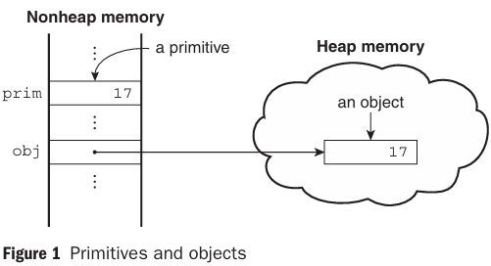
4 Primitives, Operations, and Expressions
4.1 Primitive Types
JavaScript has five primitive types: Number, String, Boolean, Undefined, and Null.
JavaScript includes predefined objects that are closely related to the Number, String, and Boolean types, named Number, String, and Boolean, respectively and they are called wrapper objects.
The purpose of the wrapper objects is to provide properties and methods that are convenient for use with values of the primitive types. In the case of Number, the properties are more useful; in the case of String, the methods are more useful.
The difference between primitives and objects is shown in the following example. Suppose that prim is a primitive variable with the value 17 and obj is a Number object whose property value is 17.

Slide 13
4.2 Numeric and String Literals
All numeric literals are primitive values of type Number.
The Number type values are represented internally in double-precision floating-point form.
Literal numbers in a script can have the forms of either integer or floating-point values.
72 7.2 .72 72. 7E2 7e2 .7e2 7.e2 7.2E-2
Integer literals can be written in hexadecimal form by preceding their first digit with either 0x or 0X.
A string literal is a sequence of zero or more characters delimited by either single quotes (') or double quotes (").
'You\'re the most freckly person I\'ve ever seen’
"D:\\bookfiles"

Slide 14
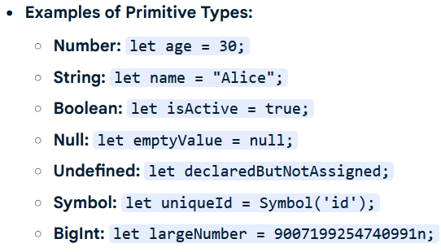
4.3 Other Primitive Types
The only value of type Null is the reserved word null, which indicates no value. A variable is null if it has not been explicitly declared or assigned a value.
Causes runtime error if it is used.
The only value of type Undefined is undefined. Unlike null, there is no reserved word undefined. If a variable has been explicitly declared, but not assigned a value, it has the value undefined. If the value of an undefined variable is displayed, the word undefined is displayed.
The only values of type Boolean are true and false.

Slide 15
4.4 Declaring Variables
One of the characteristics of JavaScript that sets it apart from most common non scripting programming languages is that it is dynamically typed.
The type of the value of a particular appearance of a variable in a program can be determined by the interpreter.
A variable can be declared either by assigning it a value, in which case the interpreter implicitly declares it to be a variable, or by listing it in a declaration statement that begins with the reserved word var.
var counter,
index,
pi = 3.14159265,
quarterback = "Elway",
stop_flag = true;

Slide 16
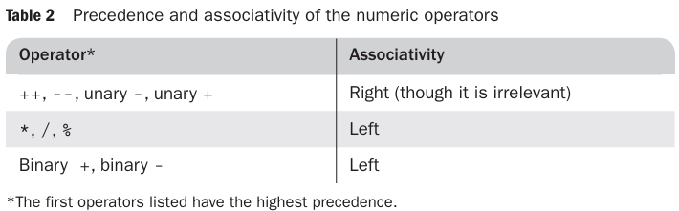
4.5 Numeric Operators
JavaScript has the typical collection of numeric operators: the binary operators + for addition, - for subtraction, * for multiplication, / for division, and % for modulus.
The unary operators are plus (+), negate (-), decrement (--), and increment (++).
The associativity rules of a language specify which operator is evaluated first when two operators with the same precedence are adjacent in an expression.

Slide 17
4.6 The Math Object
The Math object provides a collection of properties of Number objects and methods that operate on Number objects.
The Math object has methods for the trigonometric functions, such as sin (for sine) and cos (for cosine), as well as for other commonly used mathematical operations.
Among these are floor, to truncate a number; round, to round a number; and max, to return the largest of two given numbers.
Math.sin(x)

Slide 18
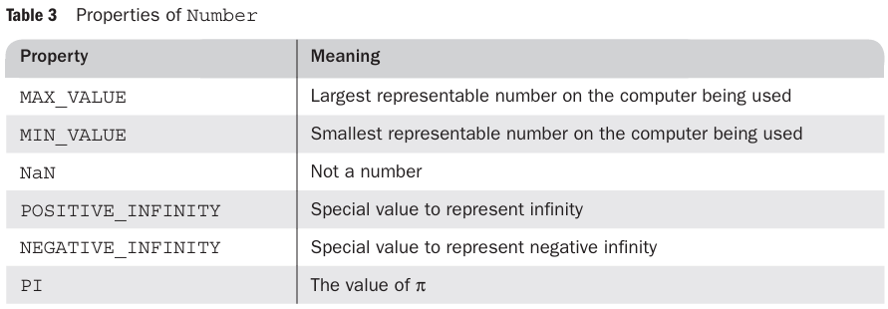
4.7 The Number Object
The Number object includes a collection of useful properties that have constant values.
var price = 427,
str_price;
. . .
str_price = price.toString();

Slide 19
4.8 The String Catenation Operator
JavaScript strings are not stored or treated as arrays of characters; rather, they are unit scalar values.
String catenation is specified with the operator denoted by a plus sign (+).
first + " Freeloader"
4.9 Implicit Type Conversions
The JavaScript interpreter performs several different implicit type conversions. Such conversions are called coercions.
If either operand of a + operator is a string, the operator is interpreted as a string catenation operator.
"August " + 1977
7 * "3"

Slide 20
4.10 Explicit Type Conversions
There are several different ways to force type conversions, primarily between strings and numbers.
Strings that contain numbers can be converted to numbers with the String constructor
Ex1:
var str_value = String(value);
Ex2:
var num = 6;
var str_value = num.toString(); //”6”
var str_value_binary = num.toString(2); //”110”
A number also can be converted to a string by catenating it with the empty string.
Strings can be explicitly converted to numbers in several different ways.
var number = Number(aString);
var number = aString - 0;
The two, parseInt and parseFloat, are not String methods, so they are not called through String objects.

Slide 21
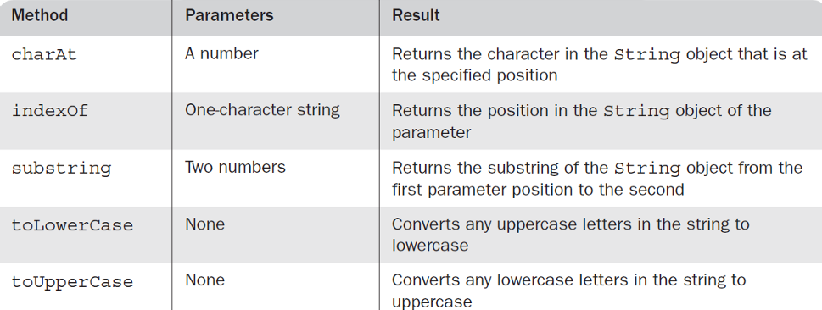
4.11 String Properties and Methods
String methods can always be used through String primitive values, as if the values were objects because of coercion
length property: gives number of characters in a string
String Methods:
var str = "George";
str.charAt(2) is 'o'
str.indexOf('r') is 3
str.substring(2, 4) is 'org'
str.toLowerCase() is 'george'

Slide 22
4.12 The typeof Operator
returns the type of its single operand
produces " number","string ", or “boolean” if the operand is of primitive type Number, String, or Boolean, respectively
If the operand is an object or null, typeof produces "object“=>Objects do not have types
If the operand is a variable that has not been assigned a value, typeof produces "undefined", reflecting the fact that variables themselves are not typed
typeof operator always returns a string
typeof operator always returns a string x and typeof (x) are equivalent

Slide 23
4.13 Assignment Statements
There is a simple assignment operator, denoted by =, and a host of compound assignment operators, such as += and /=.
a += 7;
a = a + 7;

Slide 24
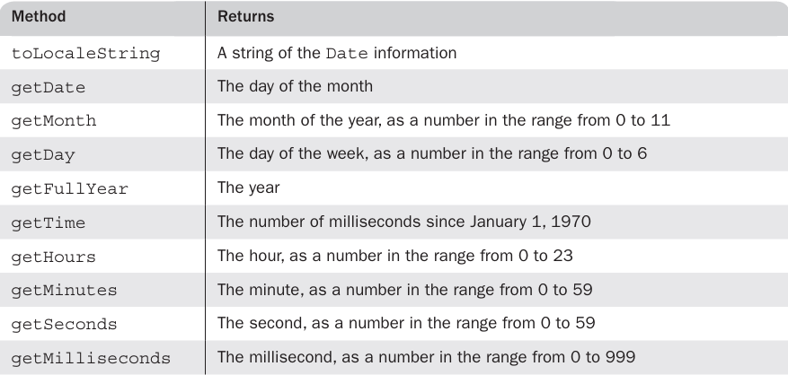
4.14 The Date Object
There are occasions when information about the current date and time is useful in a program.
A Date object is created with the new operator and the Date constructor, which has several forms.
var today = new Date();

Slide 25
5 Screen Output and Keyboard Input
A JavaScript script is interpreted when the browser finds the script or a reference to a separate script file in the body of the HTML document.
Thus, the normal output screen for JavaScript is the same as the screen in which the content of the host HTML document is displayed.
JavaScript models the HTML document with the Document object.
The window in which the browser displays an HTML document is modeled with the Window object.
The Window object includes two properties, document and window.
The Document object has several properties and methods. The most interesting and useful of its methods, is write, which is used to create output, which is dynamically created HTML document content.
document.write("The result is: ", result, "<br />");

Slide 26
Continued…
write is used to create markup
The writeln method implicitly adds "\n" to its parameter
The parameter of write can include any HTML tags and content. The parameter is simply given to the browser, which treats it exactly like any other part of the HTML document.
the Window object is the JavaScript model for the browser window. Window includes three methods that create dialog boxes for three specific kinds of user interactions:
alert
prompt
confirm

Slide 27
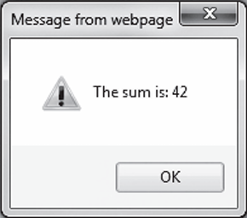
alert method:
The alert method opens a dialog window and displays its parameter in that window.
It also displays an OK button.
The string parameter of alert is not HTML code; it is plain text. Therefore, the string parameter of alert may include \n but never should include <br />.
alert("The sum is:" + sum + "\n");

Slide 28
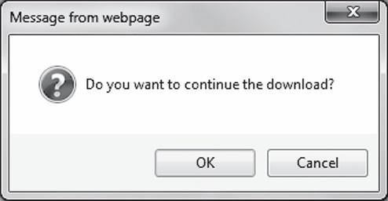
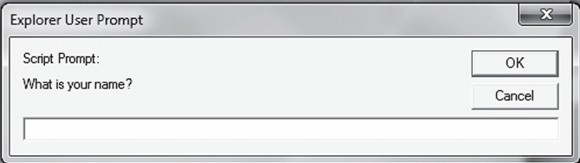
confirm method…
The confirm method opens a dialog window in which the method displays its string parameter, along with two buttons: OK and Cancel.
confirm returns a Boolean value that indicates the user’s button input: true for OK and false for Cancel.
var question = confirm("Do you want to continue this download?");
prompt method…
The prompt method creates a dialog window that contains a text box used to collect a string of input from the user, which prompt returns as its value.
As with confirm, this window also includes two buttons: OK and Cancel.
name = prompt("What is your name?", "");

Slide 29
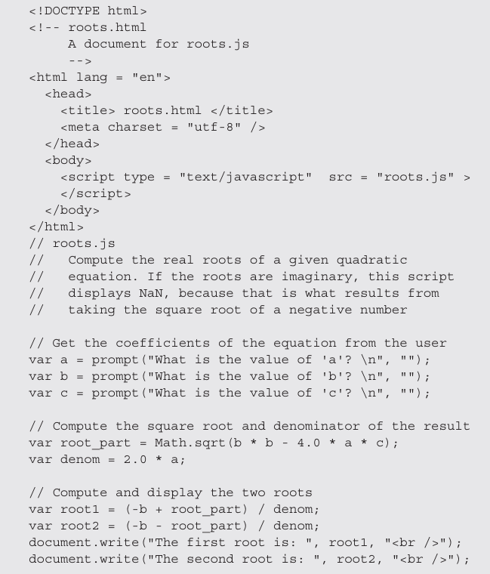

Slide 30
6 Control Statements
which provide the basis for controlling the order of execution of statements.
Control statements often require some syntactic container for sequences of statements whose execution they are meant to control.
A compound statement in JavaScript is a sequence of statements delimited by braces.
A control construct is a control statement together with the statement or compound statement whose execution it controls.
Unlike several related languages, JavaScript does not allow compound statements to create local variables.

Slide 31
6.1 Control Expressions
The expressions upon which statement flow control can be based include primitive values, relational expressions, and compound expressions.
The result of evaluating a control expression is one of the Boolean values true and false.
If the value of a control expression is a string, it is interpreted as true unless it is either the empty
string ("") or a zero string ("0").
If the value is a number, it is true unless it is zero (0).
If the special value, NaN, is interpreted as a Boolean, it is false.
If undefined is used as a Boolean, it is false.
When interpreted as a Boolean, null is false.
When interpreted as a number, true has the value 1 and false has the value 0.

Slide 32
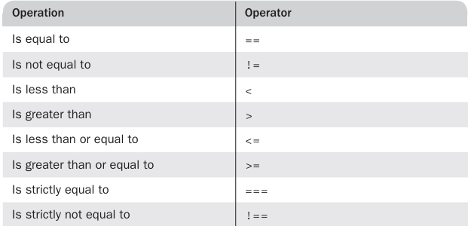
Control Statements continued…
A relational expression has two operands and one relational operator.
The last two operators in Table disallow type conversion of either operand. Thus, the expression "3" === 3 evaluates to false, while "3" == 3 evaluates to true.

Slide 33
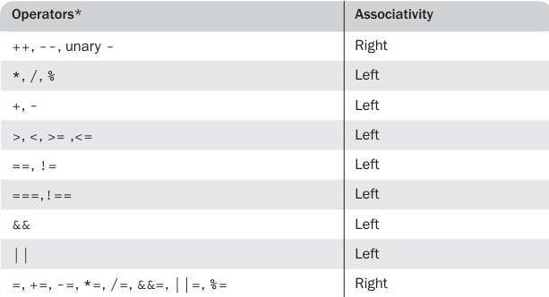
Control Statements continued…
Operator precedence and associativity

Slide 34
6.2 Selection Statements
The selection statements (if-then and if-then-else) of JavaScript are similar to those of the common programming languages. Either single statements or compound statements can be selected
if (a > b)
document.write("a is greater than b <br />");
else {
a = b;
document.write("a was not greater than b <br />",
"Now they are equal <br />");
}

Slide 35
6.3 The switch Statement
JavaScript has a switch statement that is similar to that of Java.
switch (expression) {
case value_1:
//
statement(s)
case value_2:
//
statement(s)
. . .
[default:
//
statement(s)]
}
A break statement appears as the last statement in each sequence of statements following a case.

Slide 36
6.4 Loop Statements
The JavaScript while and for statements are similar to those of Java and C++.
while (control expression)
statement or compound statement
for (initial expression; control expression; increment expression)
statement or compound statement
do statement or compound statement
while (control expression)

Slide 37
7 Object Creation and Modification
Objects are often created with a new expression, which must include a call to a constructor method.
The constructor that is called in the new expression creates the properties that characterize the new object.
In JavaScript, however, the new operator creates a blank object—that is, one with no properties.
var my_object = new Object();
In this case, the constructor called is that of Object, which endows the new object with no properties
The variable my_object references the new object. Calls to constructors must include parentheses, even if there are no parameters.

Slide 38
Continued…
The number of members of a class in Java or C++ is fixed at compile time.
The number of properties in a JavaScript object is dynamic.
At any time during interpretation, properties can be added to or deleted from an object.
A property for an object is created by assigning a value to that property’s name.
// Create an Object object
var my_car = new Object();
// Create and initialize the make property
my_car.make = "Ford";
// Create and initialize model
my_car.model = "Fusion";
There is an abbreviated way to create an object and its properties.
var my_car = {make: "Ford", model: "Fusion"};

Slide 39
Because objects can be nested, you can create a new object that is a property of my_car with properties of its own, as in the following statements:
my_car.engine = new Object();
my_car.engine.config = "V6";
my_car.engine.hp = 263;
Properties can be accessed in two ways.
var prop1 = my_car.make;
var prop2 = my_car["make"];
If an attempt is made to access a property of an object that does not exist, the value undefined is used.
A property can be deleted with delete
delete my_car.model;
JavaScript has a loop statement, for-in, that is perfect for listing the properties of an object
for (var prop in my_car)
document.write("Name: ", prop, "; Value: ", my_car[prop], "<br />");

Slide 40
8 Arrays
In JavaScript, arrays are objects that have some special functionality.
Array elements can be primitive values or references to other objects, including other arrays.
8.1 Array Object Creation
Array objects, unlike most other JavaScript objects, can be created in two distinct ways.
The usual way to create any object is with the new operator and a call to a constructor.
var my_list = new Array(1, 2, "three", "four");
var your_list = new Array(100);
The second way to create an Array object is with a literal array value, which is a list of values enclosed in brackets:
var my_list_2 = [1, 2, "three", "four"];

Slide 41
8.2 Characteristics of Array Objects
The lowest index of every JavaScript array is zero.
Access to the elements of an array is specified with numeric subscript expressions placed in brackets.
The length of an array is the highest subscript to which a value has been assigned, plus 1.
the length of an array can be set to whatever you like by assigning the length property,
my_list.length = 1002;

Slide 42
8.3 Array Methods
The join method converts all of the elements of an array to strings and catenates them into a single string.
If no parameter is provided to join, the values in the new string are separated by commas.
If a string parameter is provided, it is used as the element separator.
var names = new Array["Mary", "Murray", "Murphy", "Max"];
. . .
var name_string = names.join(" : ");
The value of name_string is now "Mary : Murray : Murphy : Max".
The reverse method reverses the order of the elements of the Array object through which it is called.
The sort method coerces the elements of the array to become strings if they are not already strings and sorts them alphabetically.
names.sort();
The concat method catenates its actual parameters to the end of the Array object on which it is called.
var names = new Array["Mary", "Murray", "Murphy", "Max"];
. . .
var new_names = names.concat("Moo", "Meow");

Slide 43
Array methods continued…
The slice method does for arrays what the substring method does for strings, returning the part of the Array object specified by its parameters, which are used as subscripts.
var list = [2, 4, 6, 8, 10];
. . .
var list2 = list.slice(1, 3);
list2 is now [4, 6].
If slice is given just one parameter, the array that is returned has all of the elements of the object, starting with the specified index.
When the toString method is called through an Array object, each of the elements of the object is converted (if necessary) to a string.
The push, pop, unshift, and shift methods of Array allow the easy implementation of stacks and queues in arrays.
var list = ["Dasher", "Dancer", "Donner", "Blitzen"];
var deer = list.pop(); // deer is "Blitzen"
list.push("Blitzen");

Slide 44
Arrays continued…
A two-dimensional array is implemented in JavaScript as an array of arrays. This can be done with the new operator or with nested array literals
// nested_arrays.js
// An example illustrating an array of arrays
// Create an array object with three arrays as its elements
var nested_array = [[2, 4, 6], [1, 3, 5], [10, 20, 30]];
// Display the elements of nested_list
for (var row = 0; row <= 2; row++) {
document.write("Row ", row, ": ");
for (var col = 0; col <=2; col++)
document.write(nested_array[row][col], " ");
document.write("<br />");
}

Slide 45
9 Functions
9.1 Fundamentals
A function definition consists of the function’s header and a compound statement that describes the actions of the function. This compound statement is called the body of the function.
A function header consists of the reserved word function, the function’s name, and a parenthesized list of parameters if there are any.
The parentheses are required even if there are no parameters.
A return statement returns control from the function in which it appears to the function’s caller.
Syntactically, a call to a function with no parameters states the function’s name followed by an empty pair of parentheses.

Slide 46
Functions continued…
JavaScript functions are objects, so variables that reference them can be treated as are other object references—they can be passed as parameters, be assigned to other variables, and be the elements of an array.
function fun() {
document.write("This surely is fun! <br/>");
}
ref_fun = fun; // Now, ref_fun refers to the fun object
fun(); // A call to fun
ref_fun(); // Also a call to fun
To ensure that the interpreter sees the definition of a function before it sees a call to the function—a requirement in JavaScript—function definitions are placed in the head of an HTML document
Normally, but not always, calls to functions appear in the document body.

Slide 47
9.2 Local Variables
The scope of a variable is the range of statements over which it is visible.
When JavaScript is embedded in an HTML document, the scope of a variable is the range of lines of the document over which the variable is visible.
A variable that is not declared with a var statement is implicitly declared by the JavaScript interpreter at the time it is first encountered in the script.
Variables that are implicitly declared have global scope—that is, they are visible in the entire HTML document
Variables that are explicitly declared outside function definitions also have global scope.
It is usually best for variables that are used only within a function to have local scope
If a variable that is defined both as a local variable and as a global variable appears in a function, the local variable has precedence, effectively hiding the global variable with the same name.

Slide 48
9.3 Parameters
The parameter values that appear in a call to a function are called actual parameters.
The parameter names that appear in the header of a function definition, which correspond to the actual parameters in calls to the function, are called formal parameters.
JavaScript uses the pass-by-value parameter-passing method. When a function is called, the values of the actual parameters specified in the call are, in effect, copied into their corresponding formal parameters, which behave exactly like local variables.
Because references are passed as the actual parameters of objects, the called function has access to the objects and can change them, thereby providing the semantics of pass-by-reference parameters.
However, if a reference to an object is passed to a function and the function changes its corresponding formal parameter then the change has no effect on the actual parameter.

Slide 49
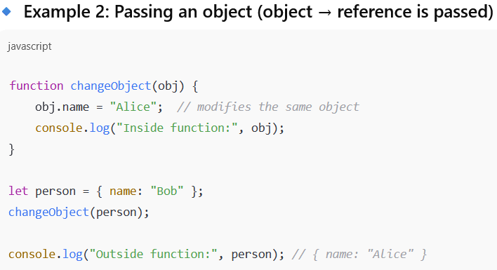
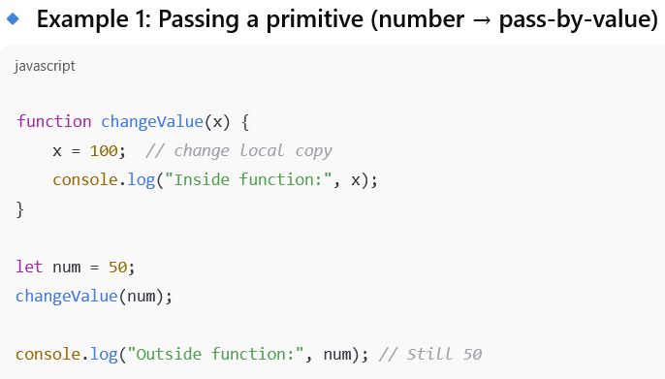
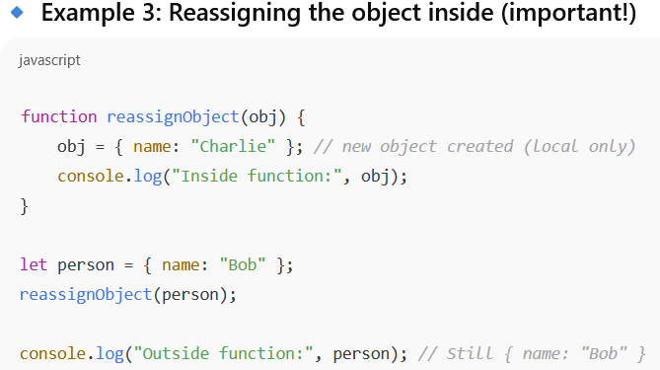
Example

Slide 50
Continued…
All parameters are communicated through a property array, arguments, that, like other array objects, has a property named length.
By accessing arguments.length, a function can determine the number of actual parameters that were passed.
function params(a, b) {
document.write("Function params was passed ", arguments.length, " parameter(s) <br />");
document.write("Parameter values are: <br />");
document.write("<br />");
}
for (var arg = 0; arg < arguments.length; arg++)
document.write(arguments[arg], "<br />");
// A test driver for function params
params("Mozart");
params("Mozart", "Beethoven");
params("Mozart", "Beethoven", "Tchaikowsky");

Slide 51
9.4 The sort Method, Revisited
sort method for array objects converts the array’s elements to strings, if necessary, and then sorts them alphabetically
If we need to sort something other than strings, or if you want an array to be sorted in some order other than alphabetically as strings, the comparison operation must be supplied to the sort method by the caller
Such a comparison operation is passed as a parameter to sort
The comparison function must return a negative number if the two elements being compared are in the desired order, zero if they are equal, and a number greater than zero if they must be interchanged
function my_order ( a,b ){return a-b;}
array.sort ( my_order )
Rather than defining a comparison function elsewhere and passing its name, the function definition can appear as the actual parameter in the call to sort
array.sort (function(a, b){return a-b};)

Slide 52
11 Constructors
JavaScript constructors are special functions that create and initialize the proper ties of newly created objects.
Every new expression must include a call to a constructor whose name is the same as that of the object being created.
this variable is used to construct and initialize the properties of the object
function car(new_make, new_model, new_year) {
this.make = new_make;
this.model = new_model;
this.year = new_year;
}
my_car = new car("Ford", "Fusion", "2012");
If a method is to be included in the object, it is initialized the same way as if it were a data property.
function display_car() {
document.write("Car make: ", this.make, "<br/>");
document.write("Car model: ", this.model, "<br/>");
document.write("Car year: ", this.year, "<br/>");
}
this.display = display_car;

Slide 53
12 Pattern Matching by Using Regular Expressions
There are two approaches to pattern matching in JavaScript: one that is based on the methods of the RegExp object and one that is based on methods of the String object.
patterns are specified in a form that is based on regular expressions, which were developed to define members of a simple class of formal languages.
Elaborate and complex patterns can be used to describe specific strings or categories of strings.
Patterns, which are sent as parameters to the pattern matching methods, are delimited with slashes.
The simplest pattern-matching method is search, which takes a pattern as a parameter.
The search method returns the position in the String object at which the pattern matched.
If there is no match, search returns –1.
var str = "Rabbits are furry";
var position = str.search(/bits/);
if (position >= 0)
document.write("'bits' appears in position", position,"<br />");
else
document.write("'bits' does not appear in str <br />");
Ans:
'bits' appears in position 3

Slide 54
12.1 Character and Character-Class Patterns
Metacharacters are characters that have special meanings in some contexts in patterns.
\ | ( ) [ ] { } ^ $ * + ? .
Metacharacters can themselves be matched by being immediately preceded by a backslash.
A period matches any character except newline. So, the following pattern matches "snowy", "snowe", and "snowd", among others:
/snow./
To match a period in a string, the period must be preceded by a backslash in the pattern. For example, the pattern /3\.4/ matches 3.4. The pattern / 3.4/ matches 3.4 and 374, among others.
It is often convenient to be able to specify classes of characters rather than individual characters. Such classes are defined by placing the desired characters in brackets.
Example: [abc]
[a-h]

Slide 55
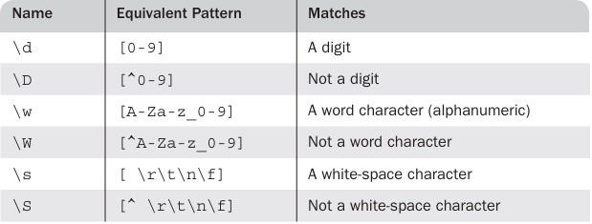
Continued…
If a circumflex character (^) is the first character in a class, it inverts the specified set.
[^aeiou]
some character classes are predefined and named and can be specified by their names
/\d\.\d\d/ // Matches a digit, followed by a period, followed by two digits
/\D\d\D/ // Matches a single digit
/\w\w\w/ // Matches three adjacent word characters

Slide 56
Continued…
/xy{4}z/ - matches xyyyyz
There are also three symbolic quantifiers: asterisk (*), plus (+), and question mark (?).
An asterisk means zero or more repetitions, a plus sign means one or more repetitions, and a question mark means one or none.
/x*y+z?/
The quantifiers are often used with the predefined character-class names
/\d+\.\d*/ - matches 99999.999
/[A-Za-z]\w*/ - matches the identifiers (a letter, followed by zero or more letters, digits, or under scores)
There is one additional named pattern that is often useful: \b (boundary), which matches the boundary position between a word character (\w) and a non word character (\W), in either order.
"A tulip is a flower" but not "A frog isn’t”:
/\bis\b/ - recognize the is but isn’t is not recognized

Slide 57
12.2 Anchors
It is useful to be able to specify that a pattern must match at a particular position in a string i.e. first or last.
A pattern can be specified to match only at the beginning of the string by preceding it with a circumflex (^) anchor.
For example, the following pattern matches "pearls are pretty" but does not match "My pearls are pretty“
/^pearl/
A pattern can be specified to match at the end of a string only by following the pattern with a dollar sign anchor.
For example, the following pattern matches "I like gold" but does not match "golden":
/gold$/

Slide 58
12.3 Pattern Modifiers
Modifiers can be attached to patterns to change how they are used, thereby increasing their flexibility. The modifiers are specified as letters just after the right delimiter of the pattern.
The i modifier makes the letters in the pattern match either uppercase or lowercase letters in the string.
For example, the pattern /Apple/i matches ‘APPLE’, ‘apple’, ‘APPle’, and any other combination of uppercase and lowercase spellings of the word “apple.”
The x modifier allows white space to appear in the pattern.
/\d+ # The street number
\s # The space before the street name
[A-Z][a-z]+ # The street name
/x
is equivalent to
/\d+\s[A-Z][a-z]+/

Slide 59
12.4 Other Pattern-Matching Methods of String
The replace method is used to replace substrings of the String object that match the given pattern.
The replace method takes two parameters: the pattern and the replacement string.
The g modifier can be attached to the pattern if the replacement is to be global in the string.
var str = "Fred, Freddie, and Frederica were siblings";
str.replace(/Fre/g, "Boy");
The match method is the most general of the String pattern-matching methods.
The match method takes a single parameter: a pattern. It returns an array of the results of the pattern-matching operation.
var str = "Having 4 apples is better than having 3 oranges";
var matches = str.match(/\d/g);
In this example, matches is set to [4, 3].

Slide 60
Continued…
The split method of String splits its object string into substrings on the basis of a given string or pattern. The substrings are returned in an array. For example, consider the following code:
var str = "grapes:apples:oranges";
var fruit = str.split(":");
In this example, fruit is set to [grapes, apples, oranges].

Slide 61

Example:
function tst_phone_num(num) {
// Use a simple pattern to check the number of digits and the dash
var ok = num.search(/^\d{3}-\d{4}$/);
if (ok == 0)
return true;
else
return false;
} // end of function tst_phone_num
// A script to test tst_phone_num
var tst = tst_phone_num("444-5432");
if (tst)
document.write("444-5432 is a valid phone number <br />");
else
document.write("Error in tst_phone_num <br />");
tst = tst_phone_num("444-r432");
if (tst)
document.write("Program error <br />");
else
document.write( "444-r432 is not a valid phone number <br />");
tst = tst_phone_num("44-1234");
if (tst)
document.write("Program error <br />");
else
document.write("44-1234 is not a valid phone number <br /");

Slide 62
JavaScript and HTML Documents:
Client-side JavaScript defines the collection of objects, methods, and properties that allow scripts to interact with HTML documents on the browser.
1 The JavaScript Execution Environment
A browser displays an HTML document in a window on the screen of the client.
The JavaScript Window object represents the window that displays the document.
All JavaScript variables are properties of some object.
The properties of the Window object are visible to all JavaScript scripts that appear either implicitly or explicitly in the window’s HTML document
When a global variable is created in a client-side script, it is created as a new property of the Window object, which provides the largest enclosing referencing environment for JavaScript scripts.

Slide 63
Continued…
There can be more than one Window object.
The JavaScript Document object represents the displayed HTML document.
Every Window object has a property named document, which is a reference to the Document object that the window displays.
The Document object is used more often than any other object in client-side JavaScript.
Every Document object has a forms array, each element of which represents a form in the document.
Each forms array element has an elements array as a property, which contains the objects that represent the HTML form elements, such as buttons and menus.
Document objects also have property arrays for anchors, links, images, and applets.

Slide 64
2 The Document Object Model:
The original motivation for the standard DOM was to provide a specification that would allow Java programs and JavaScript scripts that deal with HTML documents to be portable among various browsers.
DOM 0 is the name often applied to describe the document model used by the early browsers that supported JavaScript.
Specifically, DOM 0 is the version of the document model implemented in the Netscape 3.0 and Internet Explorer 3.0 browsers.
DOM 1, the first W3C DOM specification, issued in October 1998, focused on the HTML and XML document model.
DOM 2, issued in November 2000, specified a style-sheet object model and defined how style information attached to a document can be manipulated.
DOM 3, issued in 2004, dealt with content models for XML (DTDs and schemas), document validation, and document views and formatting, as well as key events and event groups.

Slide 65
continued:
The DOM is an application programming interface (API) that defines an interface between HTML documents and application programs.
It is an abstract model because it must apply to a variety of application programming languages. Each language that interfaces with the DOM must define a binding to that interface.
The actual DOM specification consists of a collection of interfaces, including one for each document tree node type.
They define the objects, methods, and prop erties that are associated with their respective node types.
With the DOM, users can write code in programming languages to create documents, move around in their structures, and change, add, or delete elements and their content.
Documents in the DOM have a treelike structure
in an implementation, the relationships among the elements of a document could be represented in any number of different ways.

Slide 66
continued:
A language that is designed to support the DOM must have a binding to the DOM constructs. This binding amounts to a correspondence between constructs in the language and elements in the DOM.
In the JavaScript binding to the DOM, the elements of a document are objects, with both data and operations. The data are called properties, and the operations are, naturally, called methods.
For example, the following HTML element would be represented as an object with two properties, type and name, with the values "text" and "address", respectively:
<input type = "text" name = "address">
IE8+, FX3, and C10+ provide a way of viewing the DOM structure of a displayed document. After displaying a document with IE9, select Tools/Developer Tools.

Slide 67
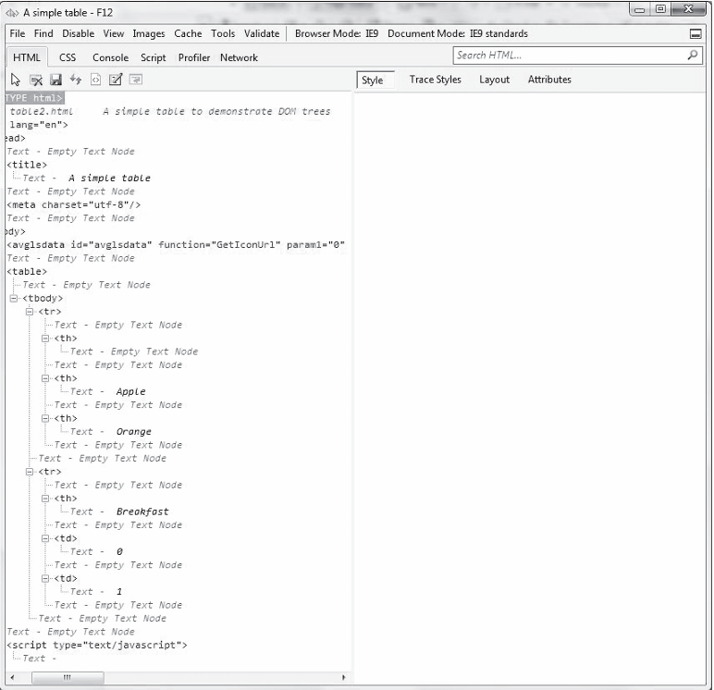
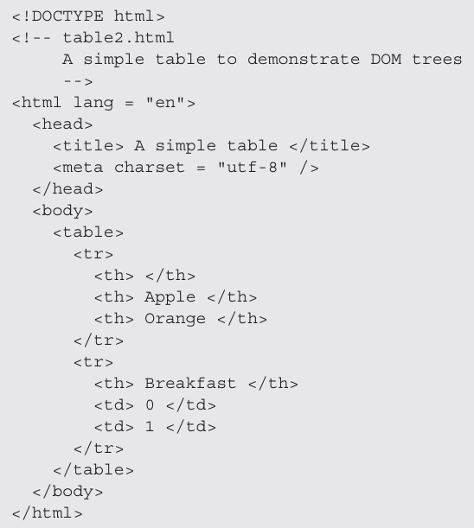
continued...

Slide 68
continued:
To be able to display the DOM structure of a document with FX3, an add on must be downloaded. The source of the download is https://addons .mozilla.org/en-US/firefox/addon/6622.
the DOM of a document can be dis played by selecting Tools/DOM Inspector.
With Chrome, to get the DOM one selects the wrench icon, Tools, and Developer Tools.

Slide 69
3 Element Access in JavaScript:
The elements of an HTML document have corresponding objects that are visible to an embedded JavaScript script.
The addresses of these objects are required, both by the event handling and by the code for making dynamic changes to documents.
The original (DOM 0) way is to use the forms and elements arrays of the Document object, which is referenced through the document property of the Window object.
We refer to the address of the JavaScript object that is associated with an HTML element as the DOM address of the element.
var dom = document.forms[0].elements[0];
The problem with this approach to element addressing is that the DOM address is defined by the position of elements in the document, which could change.

Slide 70
Continued…
Another approach to DOM addressing is to use element names.
<body>
<form name = "myForm" action = "">
<input type = "button" name = "turnItOn" />
</form>
</body>
Using the name attributes, the button’s DOM address is as follows:
var dom = document.myForm.turnItOn;
Yet another approach to element addressing is to use the JavaScript method getElementById, which is defined in DOM 1.
var dom = document.getElementById("turnItOn");

Slide 71
continued…
An alternative to both names and ids is provided by the implicit arrays associated with each checkbox and radio button group.
<form id = "vehicleGroup">
<input type = "checkbox" name = "vehicles"
value = "car" /> Car
<input type = "checkbox" name = "vehicles"
value = "truck" /> Truck
<input type = "checkbox" name = "vehicles"
value = "bike" /> Bike
</form>
var numChecked = 0;
var dom = document.getElementById("vehicleGroup");
for (index = 0; index < dom.vehicles.length; index++)
if (dom.vehicles[index].checked)
numChecked++;

Slide 72
4 Events and Event Handling:
DOM 0 event model - The HTML 4.0 standard provided the first specification of an event model for markup documents.
DOM0 model was supported by only the browsers which supports javascript
The DOM 2 model is supported by the FX3 and Chrome browsers.
4.1 Basic Concepts of Event Handling
One important use of JavaScript for Web programming is to detect certain activities of the browser and the browser user and provide computation when those activities occur.
These computations are specified with a special form of programming called event-driven programming.
In event-driven pro gramming, parts of the program are executed at completely unpredictable times, often triggered by user interactions with the program that is executing.
An event is a notification that something specific has occurred, either in the browser, such as the completion of the loading of a document, or a browser user action, such as a mouse click on a form button.

Slide 73
continued…
An event handler is a script that is implicitly executed in response to the appearance of an event.
One of the most common uses of event handlers is to check for simple errors and omissions in user input to the elements of a form, either when they are changed or when the form is submitted.
Because events are JavaScript objects, their names are case sensitive. The names of all event objects have only lowercase letters. For example, click is an event, but Click is not.
The process of connecting an event handler to an event is called registration.
There are two distinct approaches to event handler registration, one that assigns tag attributes and one that assigns handler addresses to object properties.
The write method of document should never be used in an event handler.

Slide 74
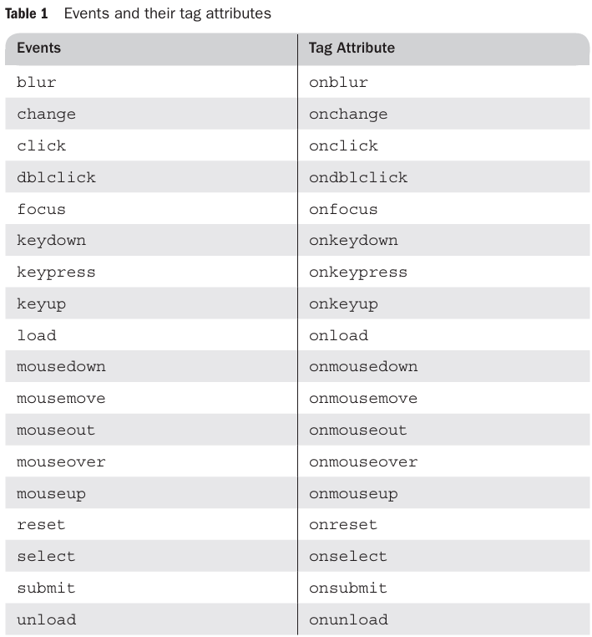
4.2 Events, Attributes, and Tags:
Events are associated with HTML tag attributes, which can be used to connect the events to handlers.
Table 1 lists the most commonly used events and their associated tag attributes

Slide 75
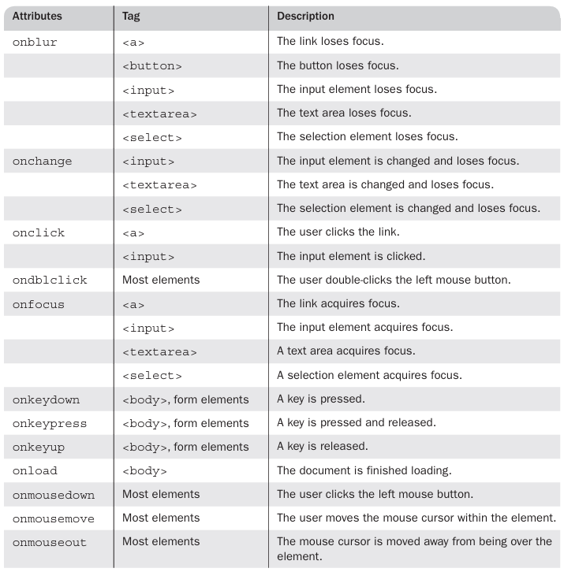
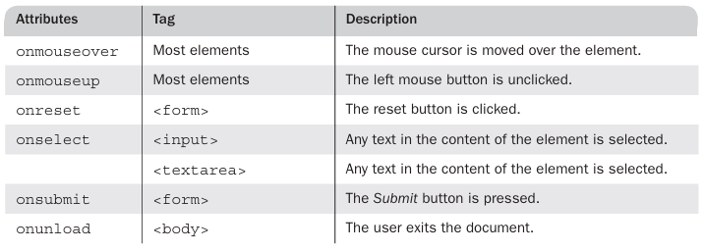
continued…
Table 2 shows (1) the most commonly used attributes related to events, (2) tags that can include the attributes, and (3) the circumstances under which the associated events are created.

Slide 76
continued…
There are two ways to register an event handler in the DOM 0 event model.
<input type = "button" id = "myButton"
onclick = "alert('You clicked my button!');" />
In many cases, the handler consists of more than a single statement. In these cases, often a function is used and the literal string value of the attribute is the call to the function.
<input type = "button" id = "myButton"
onclick = "myButtonHandler();" />
An event handler function could also be registered by assigning its name to the associated event property on the button object
document.getElementById("myButton").onclick = myButtonHandler;

Slide 77
5 Handling Events from Body Elements:
The events most often created by body elements are load and unload.
<!DOCTYPE html>
<!-- load.html
A document for load.js
-->
<html lang = "en">
<head>
<title> load.html </title>
<meta charset = "utf-8" />
<script type = "text/javascript" src = "load.js" >
</script>
</head>
<body onload="load_greeting();">
<p />
</body>
</html>
// load.js
// An example to illustrate the load event
// The onload event handler
function load_greeting () {
alert("You are visiting the home page of \n" +
"Pete's Pickled Peppers \n" + "WELCOME!!!");
}

Slide 78
6 Handling Events from Button Elements:
Buttons in a Web document provide an effective way to collect simple input from the browser user. The most commonly used event created by button actions is click.
<!DOCTYPE html>
<html>
<head>
<title>Factorial Program</title>
<script>
function findFactorial() {
let num = parseInt(document.getElementById("num").value);
let fact = 1;
if (isNaN(num) || num < 0) {
document.getElementById("result").value = "Invalid Input";
return;
}
for (let i = 1; i <= num; i++) {
fact = fact * i;
}
document.getElementById("result").value = fact;
}
</script>
</head>
<body>
<h2>Factorial of a Number</h2>
Enter a number:
<input type="text" id="num"><br><br>
<input type="button" value="Find Factorial" onclick="findFactorial()"><br><br>
Result:
<input type="text" id="result" readonly>
</body>
</html>

Slide 79
JavaScript and HTML Documents:

Slide 80
JavaScript and HTML Documents:

Slide 81
Introduction to XML
1 Introduction
2 The Syntax of XML
3 XML Document Structure
4 Document Type Definitions
5 Namespaces
6 XML Schemas
7 Displaying Raw XML Documents
8 Displaying XML Documents with CSS

Slide 82
1 Introduction
A meta-markup language is a language for defining markup languages.
The Standard Generalized Markup Language (SGML) is a meta-markup language for defining markup languages that can describe a wide variety of document types.
In 1986, SGML was approved as an International Standards Organization ( ISO) standard.
In 1990, SGML was used as the basis for the development of HTML as the standard markup language for Web documents.
In 1996, the World Wide Web Consortium ( W3C ) began work on XML, another meta-markup language.
The first XML standard, 1.0, was published in February 1998. The second, 1.1, was published in 2004.

Slide 83
Continued…
Deficiencies of HTML
HTML was defined to describe the layout of information without considering the meaning of that information.
So, regardless of the kind of information being described with HTML, only its general form and layout can be described in a document.
Example car and car price.
Another potential problem with HTML is that it enforces few restrictions on the arrangement or order of tags in a document.
<strong> Now <em> is </strong> the time </em>
One solution that addresses the deficiencies of HTML is for each group of users with common document needs to develop its own set of tags and attributes and then use the SGML standard to define a new markup language to meet those needs.

Slide 84
Continued…
An alternative solution to the problems of HTML is to define a simplified version of SGML and allow users to define their own markup languages based on it.
XML was designed to be that simplified version of SGML.
In this context, “users” refers to organizations of people with common data description and processing needs.
For example, chemists need to store chemical data in a standard format, providing a way to share data with other chemists and allowing all to use data-processing tools that work on chemical data stored in the same standard format, regardless of the origin of the data.
It is important to understand that XML was not meant to be a replacement for HTML. In fact, the two languages have different goals
HTML - describe the layout
XML - framework for defining specialized markup languages.

Slide 85
Continued…
XML provides a simple and universal way of storing any textual data.
Data stored in XML documents can be electronically distributed and processed by any number of different applications.
XML specifies rules for creating markup languages.
XML includes no tags.
XML tag and its content, together with the closing tag, are called an element.
XML documents can be written by hand with a simple text editor - Altova XMLSpy, the graphical editor for Windows, the PSGML plug-in for the Emacs editor, XMLFox, and the Morphon XML-Editor
The data in an XML document can be displayed by browsers only if the presentation styles are provided by style sheets of some kind

Slide 86
Continued…
Application programs that process the data in XML documents must analyze the documents before they gain access to the data.
This analysis is performed by an XML processor, which has several tasks, one of which is to parse XML documents, a process that isolates the constituent parts (such as tags, attributes, and data strings) and provides them to an application.
XML documents have no hidden specifications. Therefore, XML documents are plain text, which is easily readable by both people and application programs

Slide 87
2 The Syntax of XML
The syntax of XML can be thought of at two distinct levels. First, there is the general low-level syntax of XML, which imposes its rules on all XML documents.
The other syntactic level is specified by either document type definitions ( DTDs) or XML schemas.
DTDs and XML schemas specify the set of tags and attributes that can appear in a particular document or collection of documents and also the orders and arrangements in which they can appear.
An XML document can include several different kinds of statements.
The most common are the data elements of the document.
<title>Programming the Web</title>
XML documents may also include markup declarations, which are instructions to the XML parser.
<!DOCTYPE bookstore [ ... ]> - Like Schema
processing instructions, which are instructions for an application program that will process the data described in the document.
<?xml-stylesheet type="text/xsl" href="bookstyle.xsl"?> - Tells the application to use an XSL file to style/transform the XML.

Slide 88
Syntax Rules…
The XML declaration identifies the document as XML and provides the version number of the XML standard used. It may also specify an encoding standard.
Comments in XML are the same as in HTML.
XML names are used to name elements and attributes. An XML name must begin with a letter or an underscore and can include digits, hyphens, and periods – case sensitive
A small set of syntax rules applies to all XML documents.
Every XML document defines a single root element, whose opening tag must appear on the first line of XML code. All other elements of an XML document must be nested inside the root element.
Every XML element that can have content must have a closing tag. Elements that do not include content must use a tag with the following form:
<element_name />
XML tags can have attributes, which are specified with name–value assignments –“attribute value”

Slide 89
Continued…
An XML document that strictly adheres to these syntax rules is considered well formed.
<?xml version = "1.0" encoding = "utf-8"?>
<ad>
<year> 1960 </year>
<make> Cessna </make>
<model> Centurian </model>
<color> Yellow with white trim </color>
<location>
<city> Gulfport </city>
<state> Mississippi </state>
</location>
</ad>
If the data in question is an image, a reference to it can only be an attribute because such a reference cannot be the content of an element

Slide 90
In some cases, nested tags are better than attributes.
A nested element should be used if the data is subdata of the parent element’s content rather than information about the data of the parent element.
There is one situation in which an attribute should always be used: to identify numbers or names of elements, exactly as the id and name attributes are used in HTML.
An attribute also should be used if the data in question is one value from a given set of possibilities.
Finally, attributes should be used if there is no substructure or if it is really just information about the element.
<!-- A tag with one attribute -->
<patient name = "Maggie Dee Magpie">
...
</patient>
<!-- A tag with one nested tag -->
<patient>
<name> Maggie Dee Magpie </name>
...
</patient>
<!-- A tag with one nested tag, which contains three nested tags -->
<patient>
<name>
<first> Maggie </first>
<middle> Dee </middle>
<last> Magpie </last>
</name>
...
</patient>

Slide 91
3 XML Document Structure
An XML document often uses two auxiliary files: one that defines its tag set and structural syntactic rules and one that contains a style sheet to describe how the content of the document is to be printed or displayed.
The structural syntactic rules are given as either a DTD or an XML schema.
An XML document consists of one or more entities, which are logically related collections of information, ranging in size from a single character to a chapter of a book.
One of these entities, called the document entity, is always physically in the file that represents the document.
The document entity can be the entire document, but in many cases, it includes references to the names of entities that are stored elsewhere.
For example, the document entity for a technical article might contain the beginning material and ending material but have references to the article body sections, which are entities stored in separate files.

Slide 92
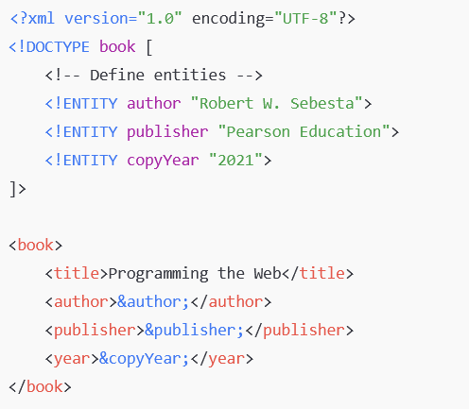
Continued…
Entity names can be any length. They must begin with a letter, a dash, or a colon.
After the first character, a name can have letters, digits, periods, dashes, underscores, or colons.
A reference to an entity is its name together with a prepended ampersand and an appended semicolon.
For example, if apple_image is the name of an entity, &apple_image; is a reference to it.

Slide 93
Continued…
When several predefined entities must appear near each other in an XML document, their references clutter the content and make it difficult to read.
In such cases, a character data section can be used. The content of a character data section is not parsed by the XML parser, so any tags it may include are not recognized as tags.
<![CDATA[ content ]]>
For example, instead of
The last word of the line is &gt;&gt;&gt; here &it;&it;&it;.
the following could be used:
<![CDATA[The last word of the line is >>> here <<<]]>
Because the content of a character data section is not parsed by the XML parser, any entity references that are included are not expanded.
<![CDATA[The form of a tag is &it;tag name&gt;]]>
The form of a tag is &it;tag name&gt; - same is printed which is there in the tag

Slide 94
4 Document Type Definitions
A document type definition ( DTD) is a set of structural rules called declarations, which specify a set of elements and attributes that can appear in a document, as well as how and where these elements and attributes may appear.
DTDs are used when the same tag set definition is used by a collection of documents – same as CSS
A DTD can be embedded in the XML document whose syntax rules it describes, in which case it is called an internal DTD.
The alternative is to have the DTD stored in a separate file, in which case it is called an external DTD.
Because external DTDs allow use with more than one XML document, they are preferable.
avoid two different notations from appearing in the same document. – DTD and XML

Slide 95
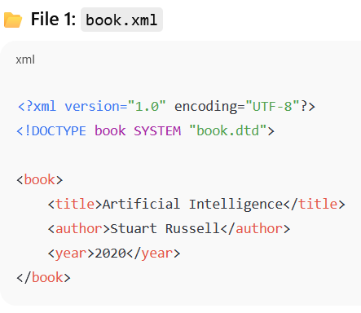
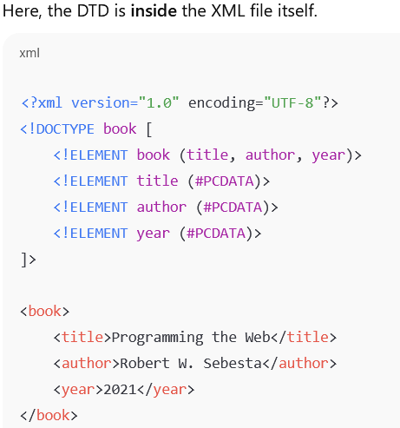
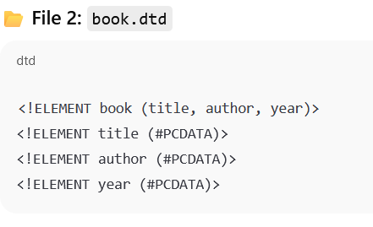
Example Internal and External DTD

Slide 96
Continued…
Syntactically, a DTD is a sequence of declarations, each of which has the form of a markup declaration
<!keyword ... >
Four possible keywords can be used in a declaration: ELEMENT, used to define tags; ATTLIST, used to define tag attributes; ENTITY, used to define entities; and NOTATION, used to define data type notations.

Slide 97
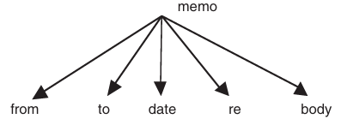
4.1 Declaring Elements
Each element declaration in a DTD specifies the structure of one category of elements.
The declaration provides the name of the element whose structure is being defined, along with the specification of the structure of that element.
If an XML document is considered as a tree, then:
An element is either a leaf node or an internal/root node in such a tree
If the element is a leaf node, its syntactic description is its character pattern
If the element is not a leaf node, its syntactic description is a list of its child elements, each of which can be a leaf node or an internal node
The form of an element declaration for elements that contain elements is
Syntax : <!ELEMENT element_name (list of names of child elements)>
Example : <!ELEMENT memo (from, to, date, re, body)>

Slide 98
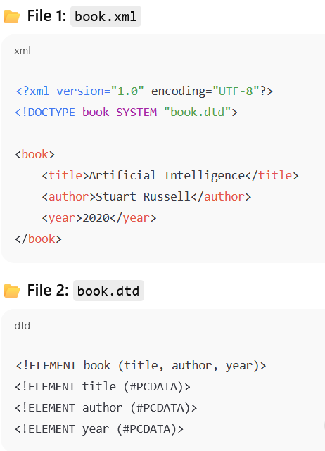
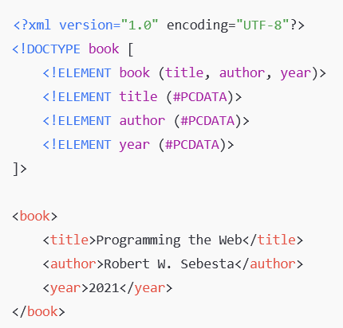
Internal DTD and External DTD:

Slide 99
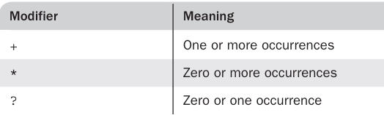
Continued…
In many cases, it is necessary to specify the number of times that a child element may appear. This can be done in a DTD declaration by adding a modifier to the child element specification.
<!ELEMENT person (parent+, age, spouse?, sibling*)>
In most cases, the content of an element is type PCDATA, for parsable character data.
Parsable character data is a string of any printable characters except “less than” (<), “greater than” (>), and the ampersand (&).
Two other content types can be specified: EMPTY and ANY.
The form of a leaf element declaration is as follows:
<!ELEMENT element_name (#PCDATA)>

Slide 100
4.2 Declaring Attributes
The attributes of an element are declared separately from the element declaration in a DTD.
An attribute declaration must include the name of the element to which the attribute belongs, the attribute’s name, its type, and a default option.
<!ATTLIST element_name attribute_name attribute type default_option>
If more than one attribute is declared for a given element, the declarations can be combined, as in the following element:
<!ATTLIST element_name
attribute name_1 attribute type default_option_1
attribute_name_2 attribute_type default_option_2
...
attribute_name_n attribute_type default_option_n
>
Attribute types may be CDATA or ENTITY

Slide 101
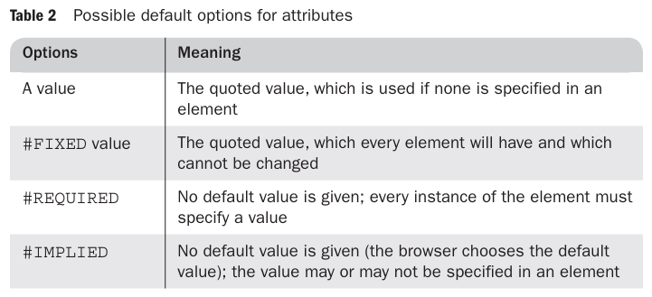
Continued…
For example, suppose the DTD included the following attribute specifications:
<!ATTLIST airplane places CDATA "4">
<!ATTLIST airplane engine_type CDATA #REQUIRED>
<!ATTLIST airplane price CDATA #IMPLIED>
<!ATTLIST airplane manufacturer CDATA #FIXED "Cessna">
Then the following XML element would be valid for this DTD:
<airplane places = "10" engine_type = "jet"> </airplane>

Slide 102
4.3 Declaring Entities
Entities can be defined so that they can be referenced anywhere in the content of an XML document, in which case they are called general entities.
The predefined entities are all general entities. Entities can also be defined so that they can be referenced only in DTDs, in which case they are called parameter entities.
<!ENTITY [%] entity_name "entity_value">
Consider the following example of an entity: Suppose that a document includes a large number of references to the full name of President Kennedy. Then you can define an entity to represent his complete name as follows:
<!ENTITY jfk "John Fitzgerald Kennedy">
Any XML document that uses a DTD that includes this declaration can specify the complete name with just the reference &jfk;

Slide 103
4.5 Internal and External DTDs
DTD can appear inside an XML document or in an external file
If the DTD is included in the XML code, it must be introduced with
<!DOCTYPE root_name [ and terminated with ]>.
<?xml version = "1.0" encoding = "utf-8"?>
<!DOCTYPE planes [
<!-- The DTD for planes -->
]>
<!-- The planes XML document -->
When the DTD is in a separate file, the XML document refers to it with a DOCTYPE declaration as its second line.
<!DOCTYPE XML_document_root_name SYSTEM "DTD_file_name">
<!DOCTYPE planes_for_sale SYSTEM "planes.dtd">

Slide 104
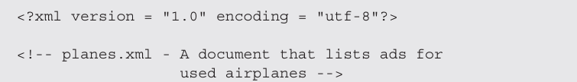
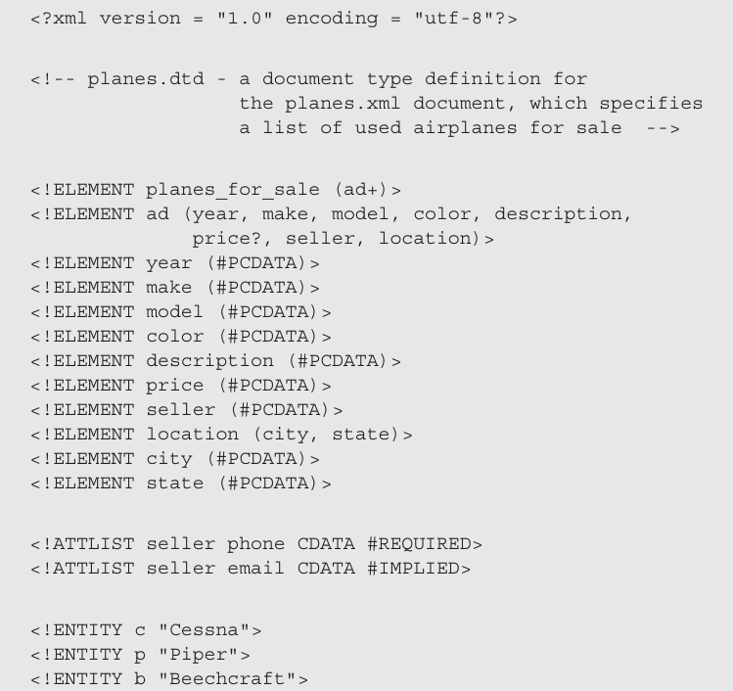
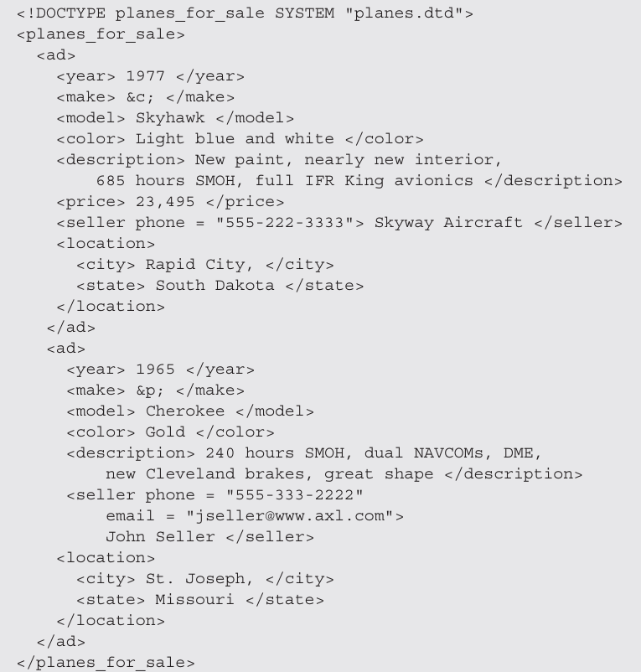
Title
Content

Slide 105
Namespaces
It is often convenient to construct XML documents that use tag sets that are defined for and used by other documents.
When a tag set is available and appropriate for a particular XML document or class of documents, it is better to use it than to invent a new collection of element types.
For example, suppose you must define an XML markup language for a furniture catalog with <chair>, <sofa>, and <table> tags.
Suppose also that the catalog document must include several different tables of specific furniture pieces, wood types, finishes, and prices.
Then it obviously would be convenient to use HTML table tags to define these tables rather than invent a new vocabulary for them.
One problem with using different markup vocabularies in the same document is that collisions between names that are defined in two or more of those tag sets could result.
software systems that process XML documents must be capable of unambiguously recognizing the element names in those documents.

Slide 106
An XML namespace is a collection of element and attribute names used in XML documents.
A namespace declaration for an element is given as the value of the xmlns attribute, as in the following:
<element_name xmlns[:prefix] = URL>
Example:
<?xml version="1.0" encoding="UTF-8"?> //More than one namespace
<catalog xmlns:furn=http://example.com/furniture
xmlns:html=http://www.w3.org/1999/xhtml>
The prefix, if included, is the name that must be attached to the names in the declared namespace.
A prefix is used for two reasons.
First, most URLs are too long to be typed on every occurrence of every name from the namespace.
Second, a URL includes characters that are invalid in XML.
<birds xmlns:bd = "http://www.audubon.org/names/species">
The names from the given namespace must be prefixed with bd
<bd:lark>

Slide 107
Continued…
The below example declares two namespaces. The first is declared to be the default namespace; the second defines the prefix, cap:
<states>
xmlns = "http://www.states-info.org/states"
xmlns:cap = "http://www.states-info.org/state-capitals"
<state>
<name> South Dakota </name>
<population> 754844 </population>
<capital>
<cap:name> Pierre </cap:name>
<cap:population> 12429 </cap:population>
</capital>
</state>
<!-- More states -->
</states>

Slide 108
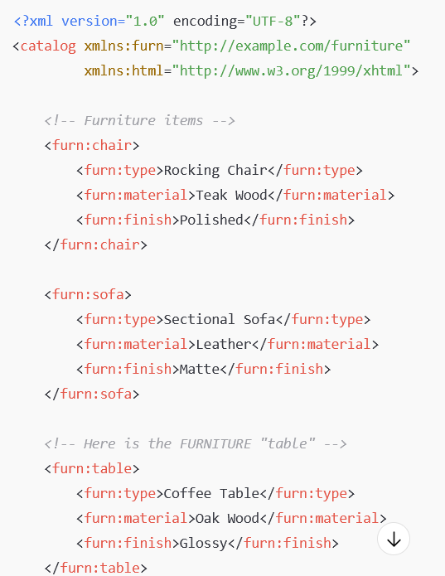
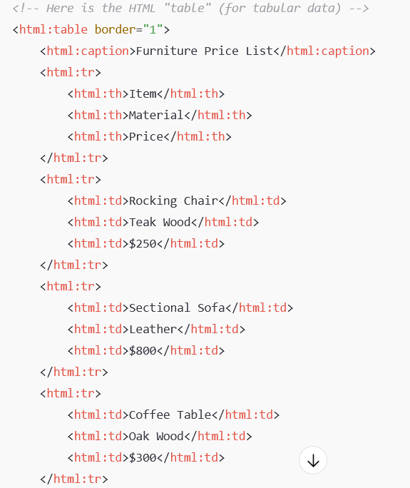
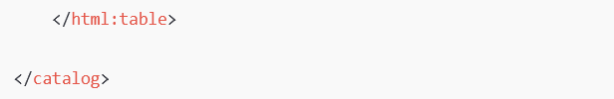
Title
Content

Slide 109
6 XML Schemas
Disadvantages of DTD:
Syntax unrelated to XML=> they cannot be analyzed with an XML processor
DTDs do not allow restrictions on the form of data that can be the content of a particular tag; e.g : DTD can only specify time as text
No scope for sequencing of child elements
No scope for including externally defined elements
XML Schema:
Primary successor to DTD and has W3C support
An XML schema is an XML document, so it can be parsed with an XML parser
Provides far more control over data types than do DTDs
User can define new types with constraints on existing data types

Slide 110
Continued…
XML Schema language is also referred to as XML Schema Definition (XSD)
It describes the structure of an XML document
XML documents that conform to a specific schema are considered instances of that schema
The purpose of an XML Schema is to define the legal building blocks of an XML document:
the elements and attributes that can appear in a document
the number of (and order of) child elements
data types for elements and attributes
Schemas themselves are written with the use of a collection of tags, or a vocabulary, from a namespace
http://www.w3.org/2001/XMLSchema
Some of the elements in the namespace are element, schema, sequence,and string

Slide 111
Continued…
Every schema has schema as its root element
Schema element specifies the namespace for the schema of schemas from which the schema’s elements and attributes will be drawn.
It often also specifies a prefix that will be used for the names in the schema
xmlns:xsd = "http://www.w3.org/2001/XMLSchema ”
A schema defines a namespace in the same sense as a DTD defines a tag set
The name of the namespace defined by a schema must be specified with the targetNamespace attribute of the schema element.
The name of every top level (not nested) element that appears in a schema is placed in the target namespace, which is specified by assigning a namespace to the target namespace attribute:
targetNamespace = "http://cs.uccs.edu/planeSchema"

Slide 112
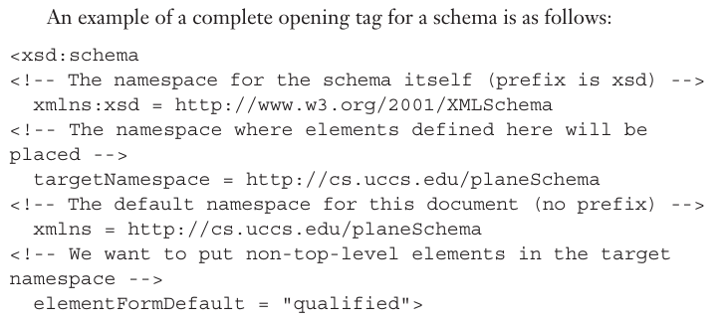
Continued…
If the names of the elements and attributes that are not defined directly in the schema element (because they are nested inside top level elements) are to be included in the target namespace, schema’s elementFormDefault must be set to qualified
elementFormDefault = "qualified“
The default namespace which is the source of the unprefixed names in the schema, is given with another xmlns specification.
xmlns = "http://cs.uccs.edu/ planeSchema "

Slide 113
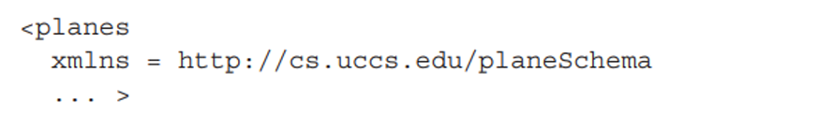
DEFINING A SCHEMA INSTANCE
An instance of a schema must include specifications of the namespaces it uses
These specifications are given as attribute assignments in the tag for the root element of the schema
An instance document normally defines its default namespace to be the one defined in its schema
Second attribute is used to name the standard namespace for instances, which includes the name XMLSchemainstance
This namespace corresponds to the XMLSchema namespace used for schemas

Slide 114
DATA TYPES
Categories of user defined schema data types:
Simple data type : Cannot include nested elements or attributes
Complex type : can have attributes and include other data types as child elements

Slide 115
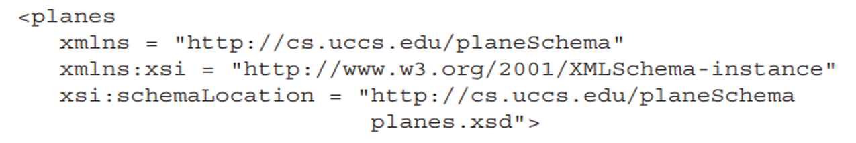
SIMPLE TYPES
Elements are defined in an XML schema with the element tag, which is from the XMLSchema namespace
prefix xsd is normally used for names from this namespace.
An element that is named includes the name attribute for that purpose. The other attribute that is necessary in a simple element declaration is type, which is used to specify the type of content allowed in the element.
An element can be given a default value with the default attribute:
Constant values are given with the fixed attribute

Slide 116
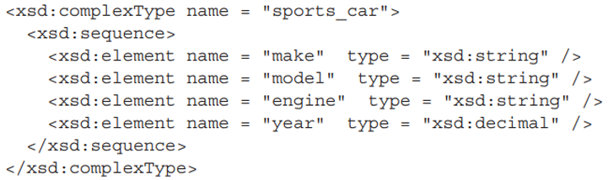
COMPLEX TYPES
Complex types are defined with the complexType tag
The sequence element is used to contain an ordered group of elements
A complex type whose elements are an unordered group is defined in an all element
The choice element can contain any number of elements, only one of which can appear in any XML document that complies with the schema.
minOccurs and maxOccurs attributes can be used to specify the numbers of occurrences of elements
The possible values of minOccurs are the nonnegative integers (including zero)
The possible values for maxOccurs are the nonnegative integers plus the value unbounded

Slide 117
XML File
<class>
<student>
<firstname>Graham</firstname>
<lastname>Bell</lastname>
<age>20</age>
</student>
</class>

Slide 118
XSD File:
<xs:schema attributeFormDefault="unqualified" elementFormDefault="qualified" xmlns:xs="http://www.w3.org/2001/XMLSchema">
<xs:element name="class">
<xs:complexType>
<xs:sequence>
<xs:element name="student"> //maxOccurs =“2” minOccurs=“0”
<xs:complexType>
<xs:sequence>
<xs:element type="xs:string" name="firstname"/>
<xs:element type="xs:string" name="lastname"/>
<xs:element type="xs:byte" name="age"/>
</xs:sequence>
</xs:complexType>
</xs:element>
</xs:sequence>
</xs:complexType>
</xs:element>
</xs:schema>

Slide 119
DISPLAYING RAW XML DOCUMENTS
If an XML document is displayed without a style sheet that defines presentation styles for the document’s tags, the displayed document will not have formatted content
The display of such an XML document is only a somewhat stylized listing of the XML markup

Slide 120
DISPLAYING XML DOCUMENTS WITH STYLESHEETS
Style sheet information can be provided to the browser for an XML document in two ways
Using Cascading Style Sheet (CSS) file
Using XSLT style sheet technology
DISPLAYING XML DOCUMENTS WITH CSS
The connection of an XML document to a CSS style sheet is established with the processing instruction xml-stylesheet which specifies the particular type of the style sheet via its type attribute and the name of the file that stores the style sheet via its href attribute

Slide 121
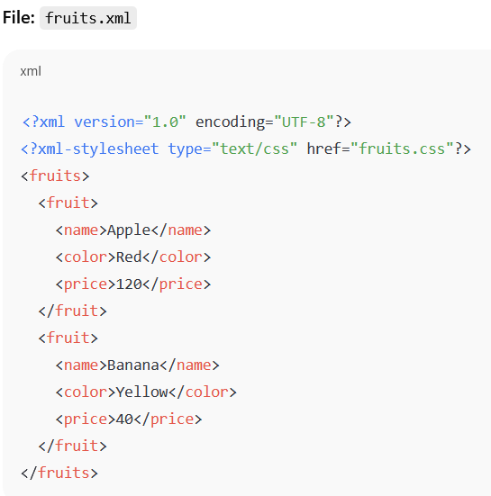
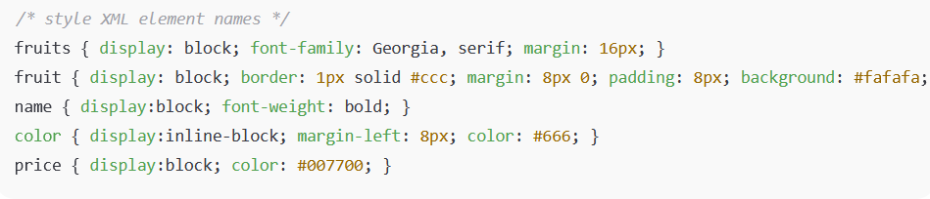

Slide 122
XSLT STYLE SHEETS
XSL (eXtensible Stylesheet Language) is a styling language for XML.
XSLT stands for XSL Transformations
XPath is a language for navigating in XML documents
XSLT is used to transform an XML document into another XML document, or another type of document that is recognized by a browser, like HTML and XHTML.
In the transformation process, XSLT uses XPath to define parts of the source document that should match one or more predefined templates.
When a match is found, XSLT will transform the matching part of the source document into the result document

Slide 123
Continued…
Templates:
An XSL style sheet consists of one or more set of rules that are called templates.
A template contains rules to apply when a specified node is matched.
The < xsl:template > element is used to build templates.
The match attribute is used to associate a template with an XML element.
The match attribute can also be used to define a template for the entire XML document.
The value of the match attribute is an XPath expression (i.e. match="/" defines the whole document).

Slide 124
Continued…
The < xsl:value-of > element can be used to extract the value of an XML element and add it to the output stream of the transformation
The XSL < xsl:for-each> element can be used to select every XML element of a specified node-set
The < xsl:apply-templates > element applies a template rule to the current element or to the current element's child nodes.
If we add a "select" attribute to the < xsl:apply-templates > element, it will process only the child elements that matches the value of the attribute. We can use the "select" attribute to specify in which order the child nodes are to be processed

Slide 125
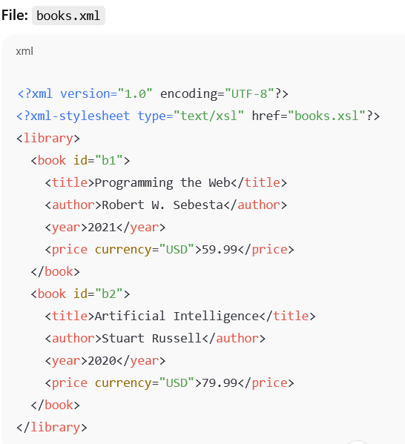
Title
Content

Slide 126
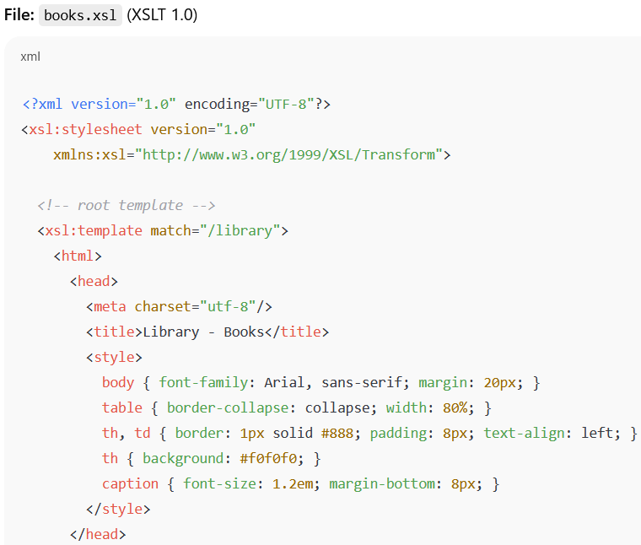
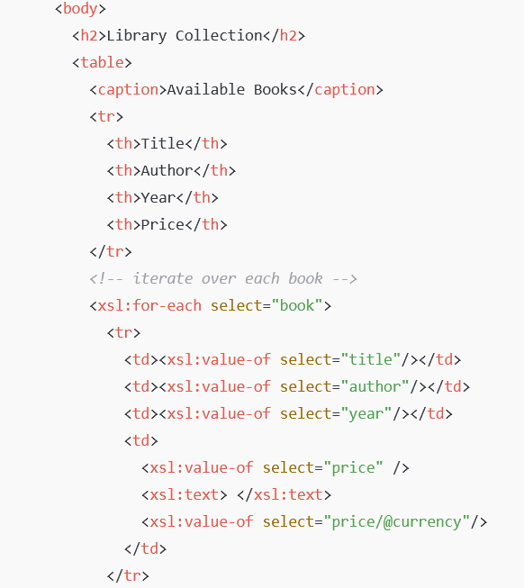
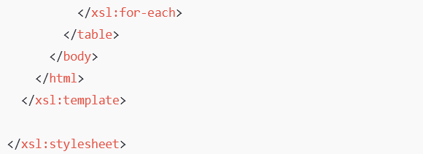
Title
Content

Slide 127
END

